Slide 1

Mathematica for
Engineers
Meeting 1 - Overview and Introduction to Mathematica

Slide 2
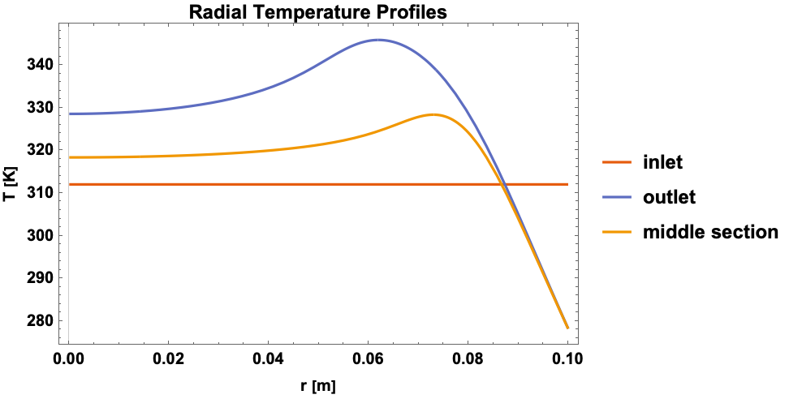
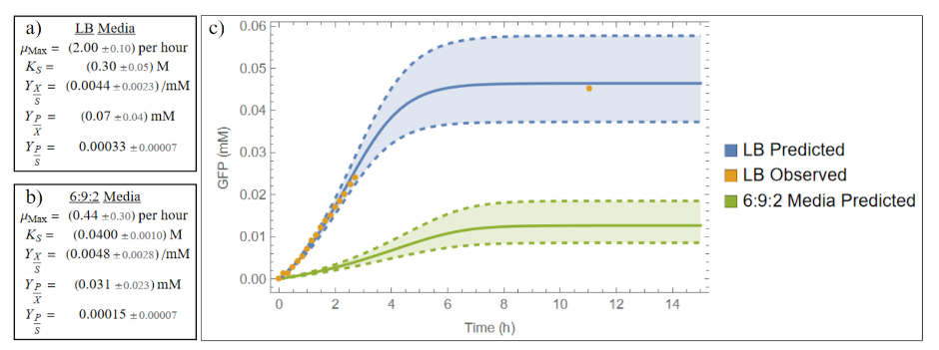
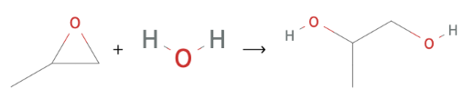
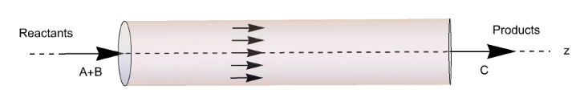
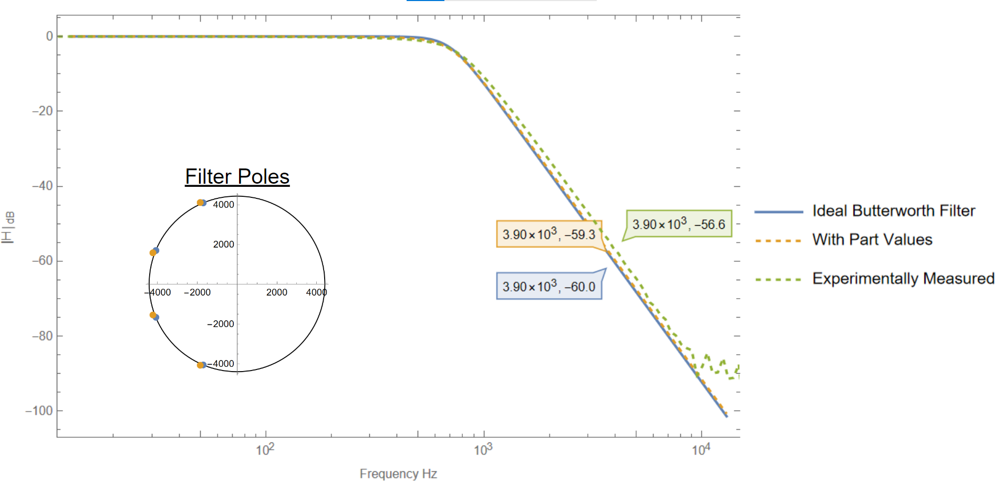
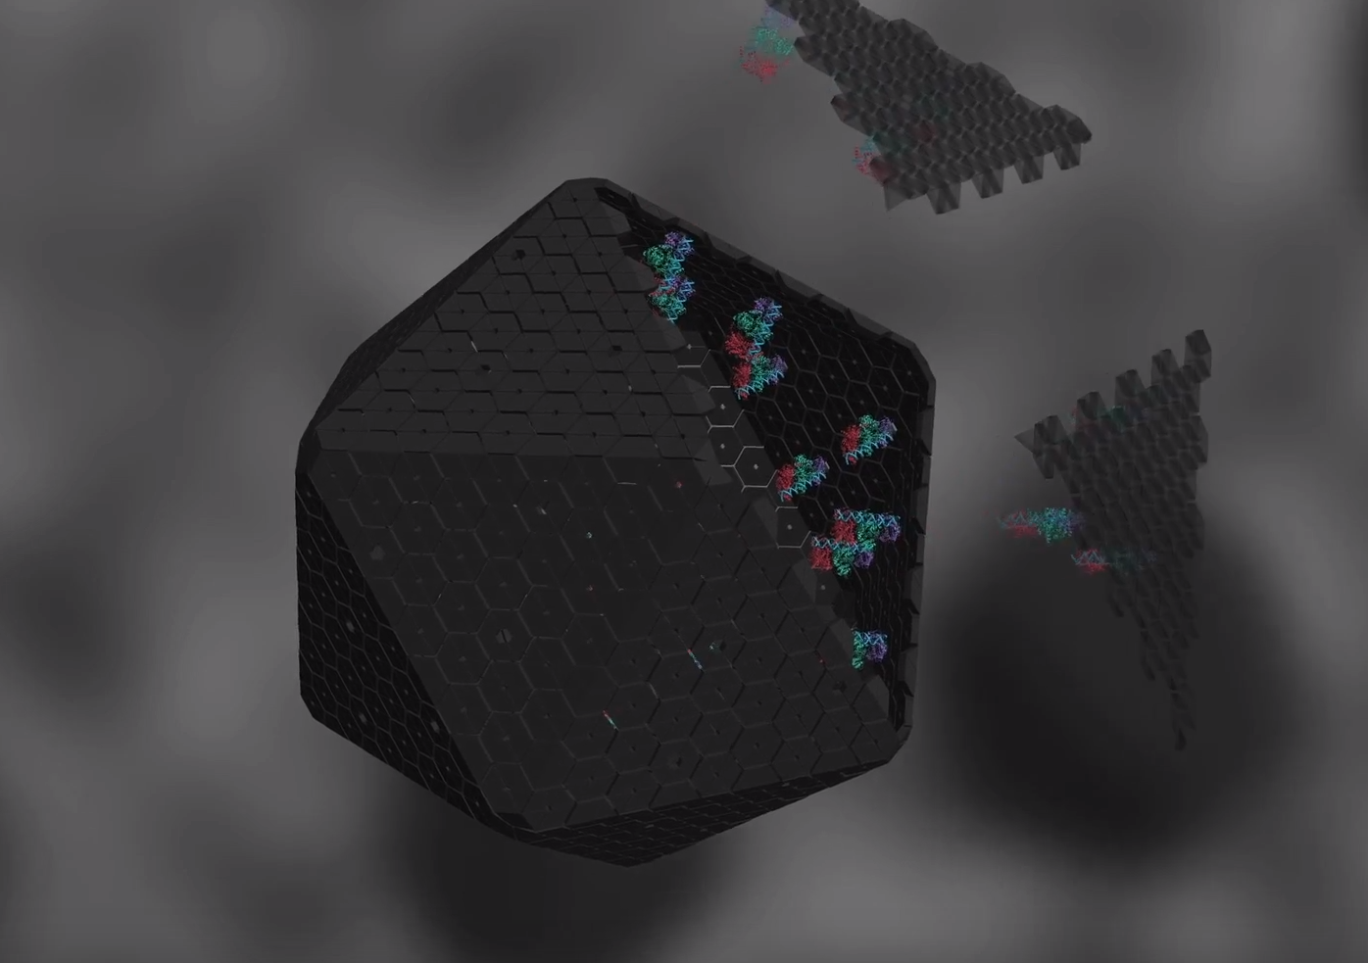
About me
ChemE Major
Biotech Concentration
EE Minor
Bio Minor + Syn Bio Research

Slide 3

“Why do I need Mathematica?”

Slide 4
You Don’t

Slide 5
You Don’t
But you should really want to use it

Slide 6





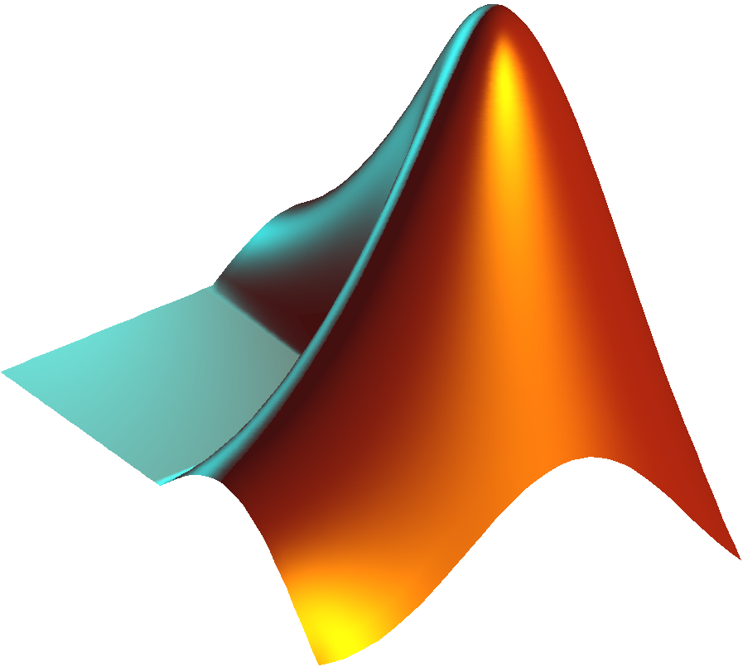

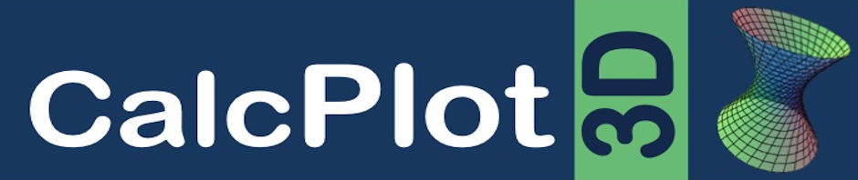
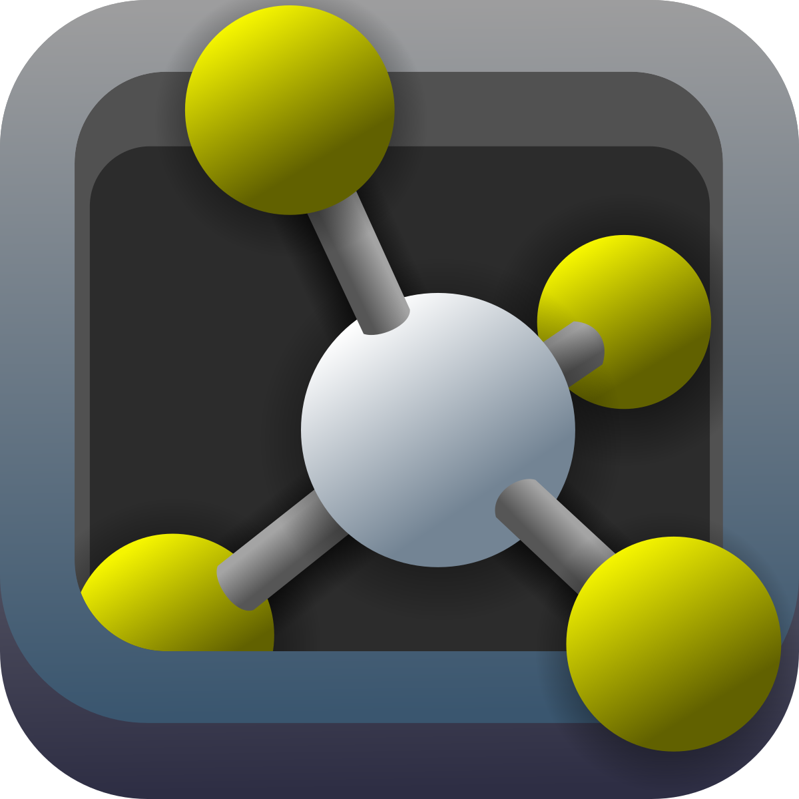


You can do many of the things mathematica can do using other tools

Slide 7





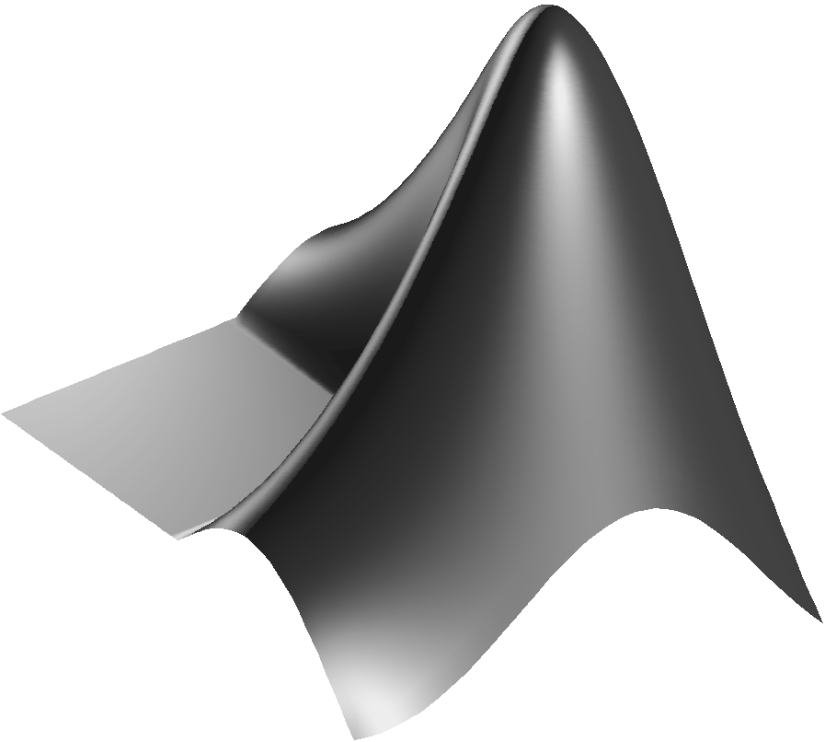

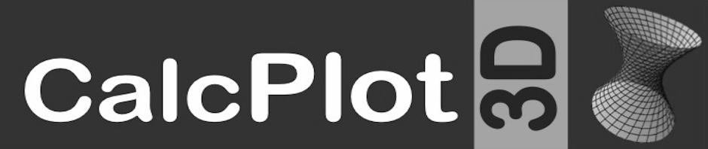

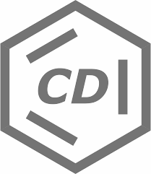

But why switch between hundreds of programs when you could do it all in one

Slide 8
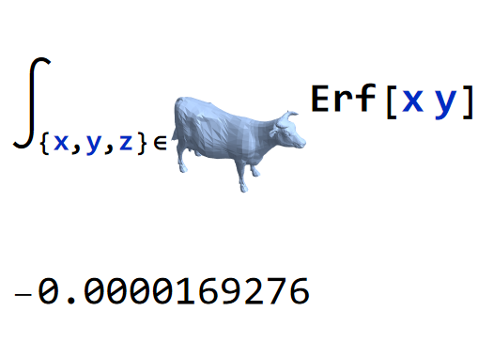
But wait, there’s more!

Slide 9
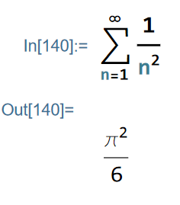
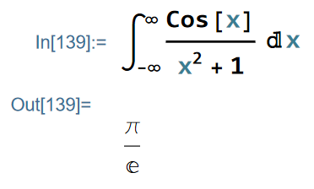
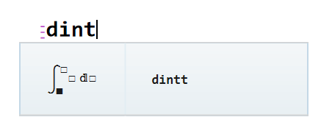
The GUI and “syntax” are unparalleled
1
Type it like you write it

Slide 10
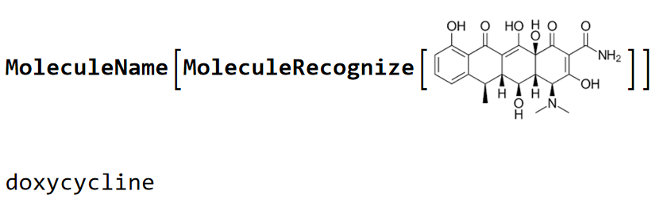
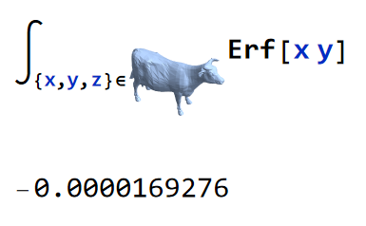
The GUI and “syntax” are unparalleled
1
2
Type it like you write it
In-line references

Slide 11
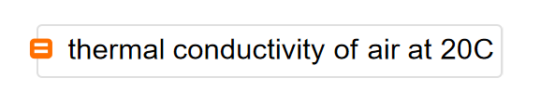
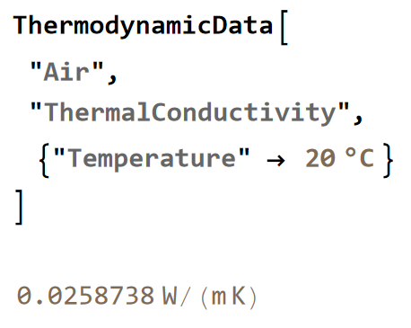
The GUI and “syntax” are unparalleled
1
2
3
Type it like you write it
In-line references
Semantic Interpretation

Slide 12
Why use Mathematica?
1
2
She does it all
And she’s pretty
Don’t waste time trying to learn and switch between multiple programs, just do it all in one and only learn how to use one piece of software
Notebook format and syntax formatting options make manipulating information, data, and code a breeze.

Slide 13
And this equals lots of time saved!
Time is one of our most valuable resources
Doing things quicker makes harder things worth doing

Slide 14
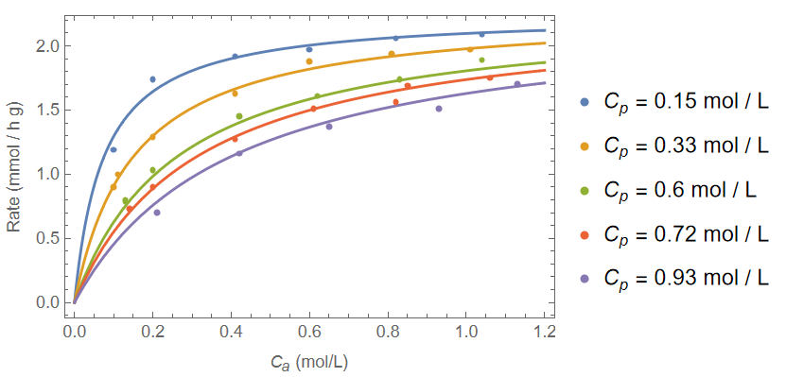
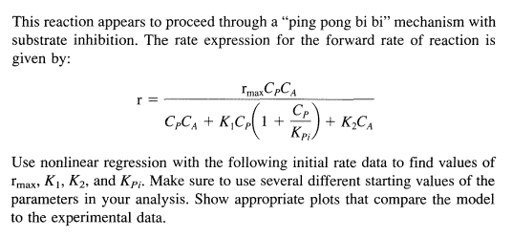
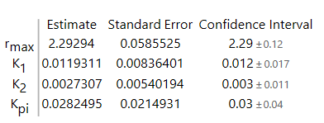
A prime example I see all the time

Slide 15
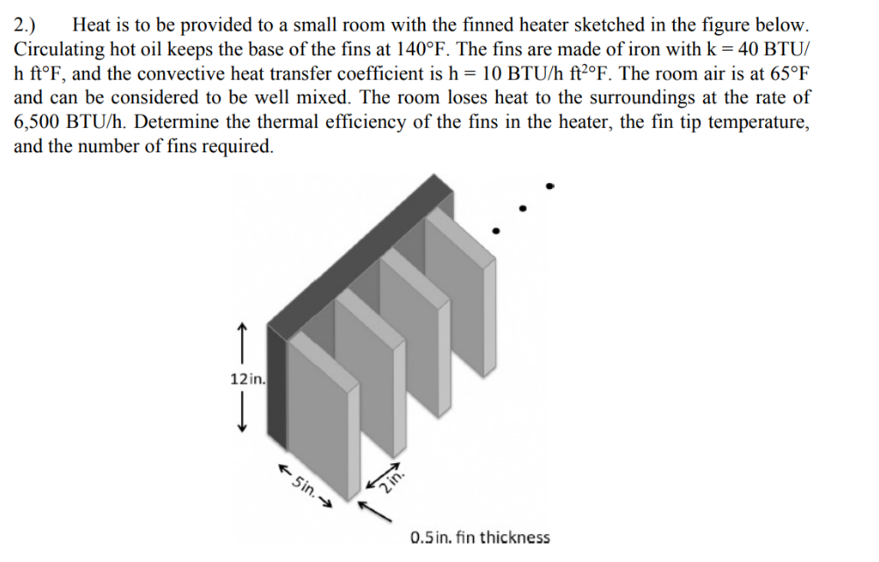
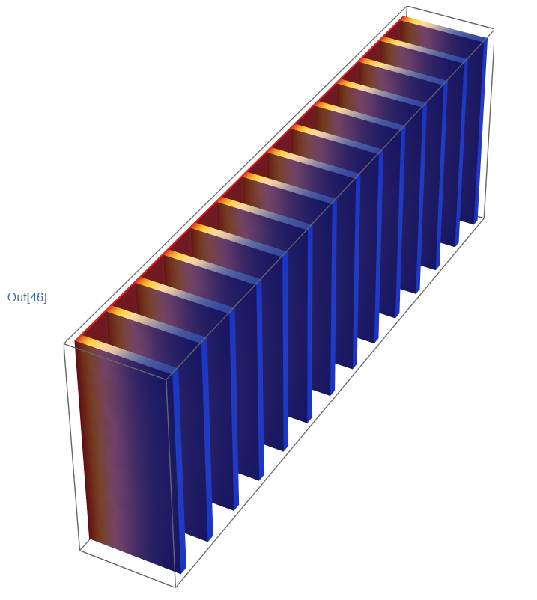
Another cool example

Slide 16
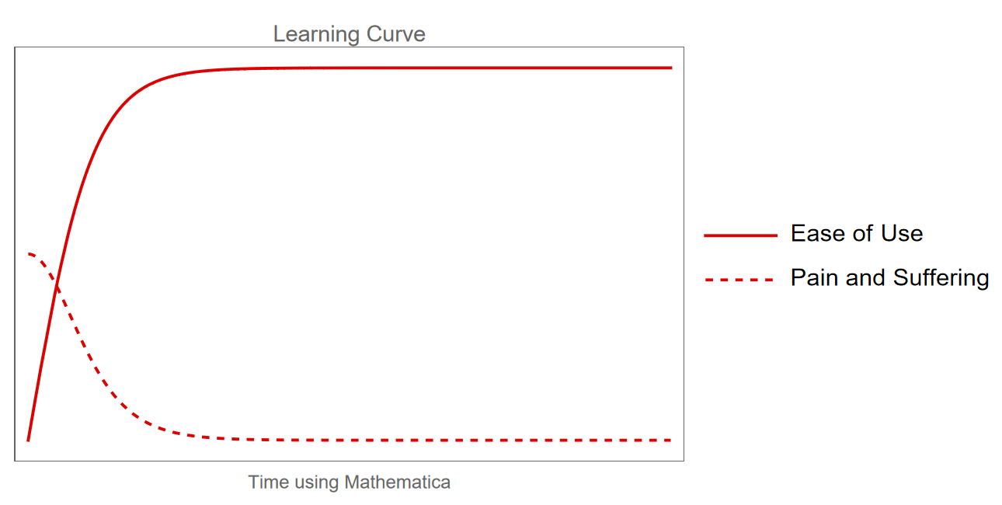
The only bad news

Slide 17
But that’s why I made this course!

Slide 18
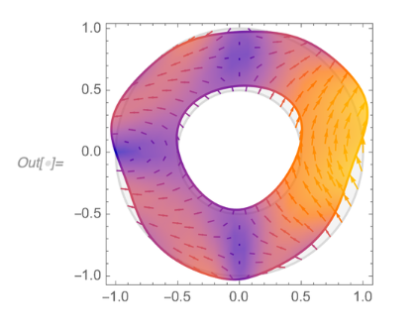
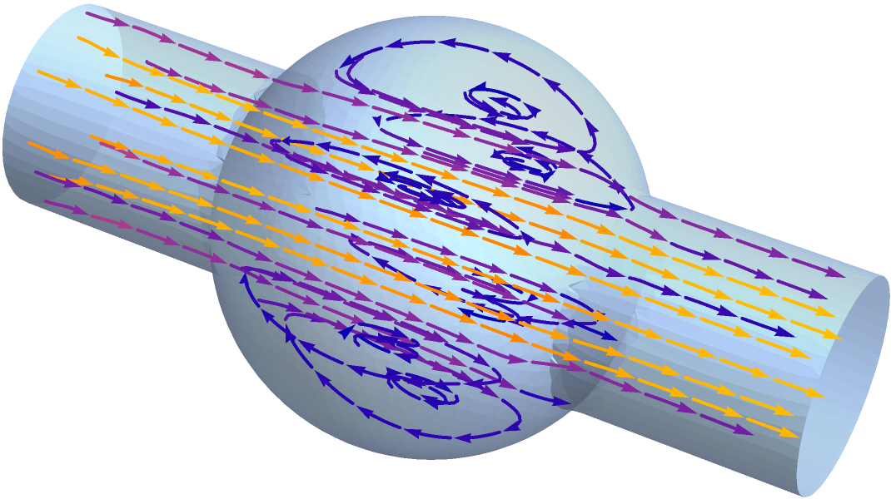
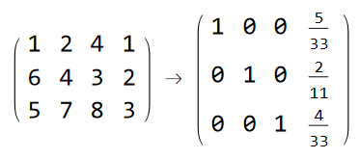
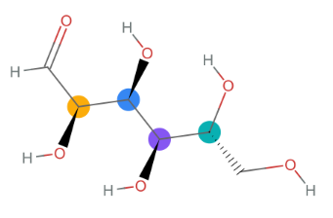
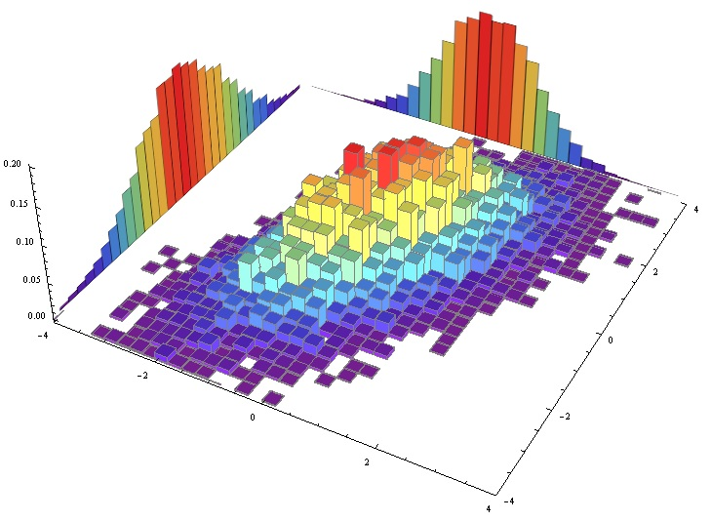
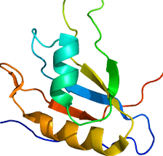
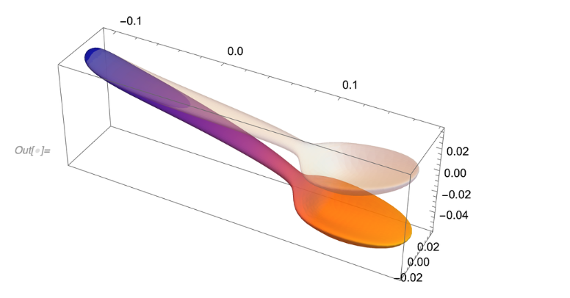
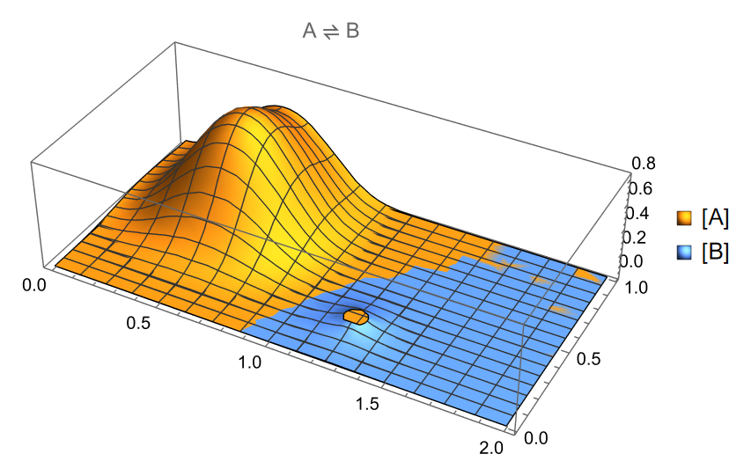
What about you?
Symbolic algebra and calculus?
Unit analysis?
ODE and PDE solving?
Root finding?
Function Optimization?
Statistical Analysis?
Parsing Data?
Data and function visualization?
Organic Chemistry?
Linear algebra?
Making animations?
Literally anything?

Slide 19
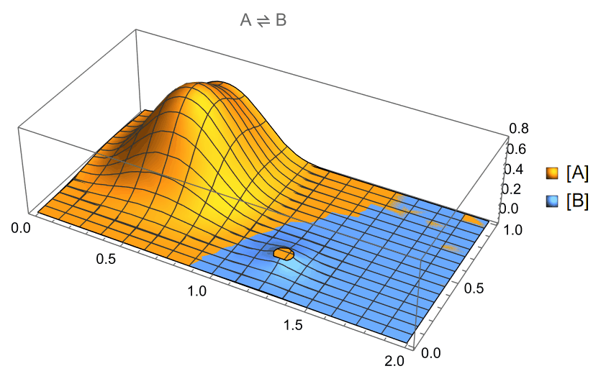
What about you?
Symbolic algebra and calculus?
Unit analysis?
ODE and PDE solving?
Root finding?
Function Optimization?
Statistical Analysis?
Parsing Data?
Data and function visualization?
Organic Chemistry?
Linear algebra?
Making animations?
Literally anything?

Slide 20
But now it’s time to learn how to fish

